Slide 1
Thinking Like A Computer
Skills to help you outline and (eventually) debug code
Andie M. Creel

Slide 2

My motivation for knowing how to program
Sustainable development: "meets the needs of the present without compromising the ability of future generations to meet their own needs” -- Brundtland Report, 1987
Needs: consumption of goods, health, political stability, culture
The environment affects this
That effect can be hard to observe/measure
The explosion of data and computing power can help us observe and understand how nature affects sustainable development
“What gets measured gets managed” – Peter Drucker (maybe?)
Notes:
Brundtland report is when the world realized GDP wasn’t a good indicator of progresses and welfare when used on its own
Peter drucker is a management consultant

Slide 3

Goal of my Foundation Lectures
Get rid of the intimidation factor
Build a foundation to build on
Accelerate the initial learning curve
(I tried to build what I wish I had)

Slide 4
What is programming
Bits and bytes – what the computer actually speaks (0s and 1s)
Machine and Assembly languages -- translates our code to 0s and 1s
Code – R, Python, etc.
Software – Windows, iOS, Applications, Excel, R Studio

Slide 5
What is programming
Bits and bytes – what the computer actually speaks (0s and 1s)
Machine and Assembly languages -- translates our code to 0s and 1s
Code – R, Python, etc.
Software – Windows, iOS, Applications, Excel, R Studio

Slide 6
Some definitions
Code: What your computer runs (different languages)
Script: The text file where you write your code
Comments: Notes you write yourself that the computer doesn’t read
Run (aka compile and execute): when the computer executes your code
IDE/GUI/Software
Where you write and run your scripts and comments
R Studio, Jupyter Notebooks, Google Collab (Collaboratory)
Notes:
IDE: integrated development environment

Slide 7
Why should you think like a computer?
Clear definition of “problems”
Cannot solve a problem that isn’t defined (how do you know it's solved?)
Forces precision and accuracy in problem definition
Collaboration: Once clear to you, can also be clear to team members
Solutions to “problems”
Environmental field is filled with giant problems
To make progress, need to break them into solvable pieces
Learning to program is learning how to break big problems down
Steps are clear
Notes:
Lets back out
Why is it important to think like a computer (more than coding)
Clear definition of “problems”
Cannot solve a problem that isn’t defined (how do you know its solved?)
Coding forces precision and accuracy in problem definition
Collaboration: Once clear to you, can also be clear to team members
Solutions to “problems”
Our field is filled with giant problems
To make progress, need to break them into solvable pieces
Learning to program is learning how to break big problems down
Steps are clear

Slide 8
Why should you learn to code?
Efficiency and Speed: it’s so much faster
Accurate: not reliant on copy-paste/find-replace
Replicability: teams, peer review, new datasets
Customizable: write models for your data, clean and manipulate data for your models
Employment: more jobs, better jobs, more money
Collaboration: compared to Excel, later in certificate we’ll discuss Github
Notes:
Now lets zoom in, why is it worth learning how to code?
Efficiency and Speed – its so much faster
Accurate – not reliant on copy-paste/find-replace
Replicability – for your teams, others, new datasets
Customize – write models for your data, clean and manipulate data for your models
Employment – more jobs, better jobs, more money -- Varies wildly, but on average, people who code make 20-30% more which is something like 10-20k more per year
Collaboration – compared to excel, GitHub on last day

Slide 9
Pseudo Code – first step of coding
What
Pseudo code is the outline of your code
Similar to the writing process
Not a coding language
I do it on scrap paper or in comments at the top of my scripts
Why
Clarify your logic
Serves as road map and plan
Super important for multiple work sessions
Collaboration/Documentation
Can communicate what you’ve done/are doing to others
Notes:
Why
Clarify your logic – are you solving the problem?
Serves as road map and plan – important for multiple work sessions
Collaboration/Documentation – can communicate what you did to others

Slide 10
Exercise One: Coffee
Write “instructions” for how to brew a cup of coffee/tea
[pause video for 3 min to do so]

Slide 11
Exercise One: Coffee
My Pseudo Code
Step 1: Fill coffee machine with water
Step 2: Turn on machine to boil water
Step 3: While waiting for water to boil
a. Place coffee filter in coffee maker
b. Add coffee grounds to filter
Step 4: Wait for coffee to drip through the filter
Step 5: Remove filter and discard used grounds
Step 6: Pour coffee into a mug
Step 7: Add any desired milk or sugar
Step 8: Stir and enjoy

Slide 12
Exercise One: Coffee
Take Aways
Is your pseudo code the same as mine?
Probably not!
And that’s good!
A critical part is the problem definition (i.e., the goal)
Many solution strategies could work
Both you and I outlined steps to achieve the well-defined goal of brewing a cup of coffee
We each solved the problem
But solution strategy was different

Slide 13
Exercise Two: Rock Paper Scissors
Write instructions for how to play Rock, Paper, Scissors
[pause video for 5 min to do so]

Slide 14
My pseudo code (lazy)
Player: choose rock paper scissor
Computer: random generate rock paper scissor
Compare P & C
If P = Rock
And C = Rock: tie
And C = paper: player loses
And C = scissors: player wins
Same for if P = paper and P = Scissors

Slide 15
Not Lazy Pseudo Code
While play_again is true
Prompt the player to select Rock, Paper, or Scissors
Generate a random choice for the computer (Rock, Paper, or Scissors)
If player's choice is the same as computer's choice
Display "It's a tie!"
Else If player chooses Rock and computer chooses Scissors
Display "Player wins! Rock crushes Scissors."
Else If player chooses Paper and computer chooses Rock
Display "Player wins! Paper covers Rock."
Else If player chooses Scissors and computer chooses Paper
Display "Player wins! Scissors cut Paper."
Else
Display "Computer wins!"
Ask the player if they want to play again
set play_again to true or false
Notes:
This if else is very elegant because it considers how the player can win, then puts everything else in another case

Slide 16
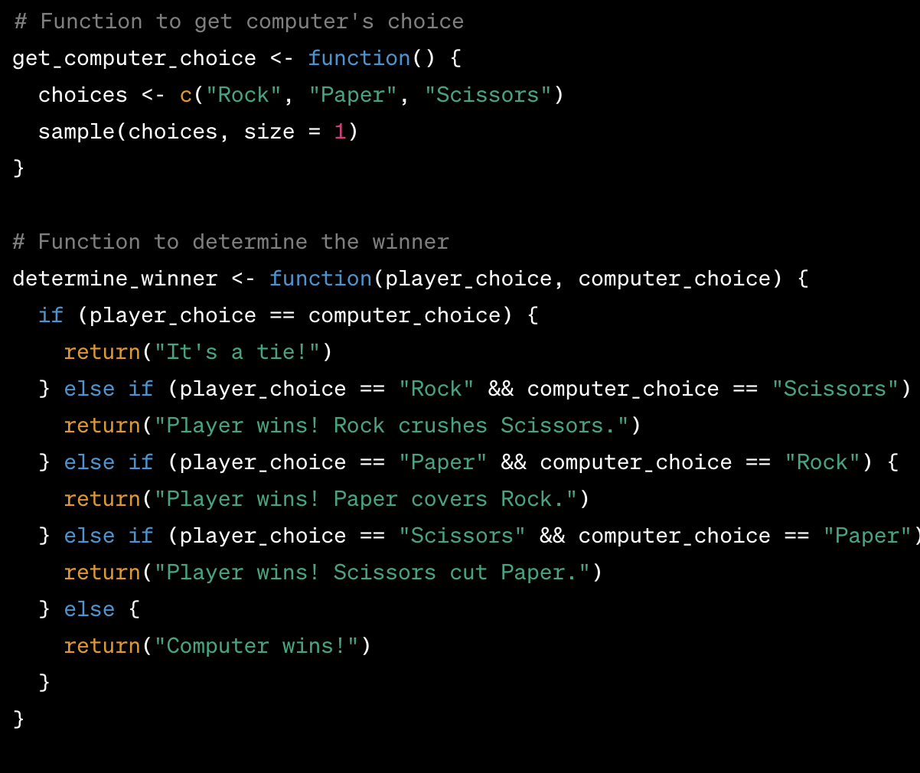
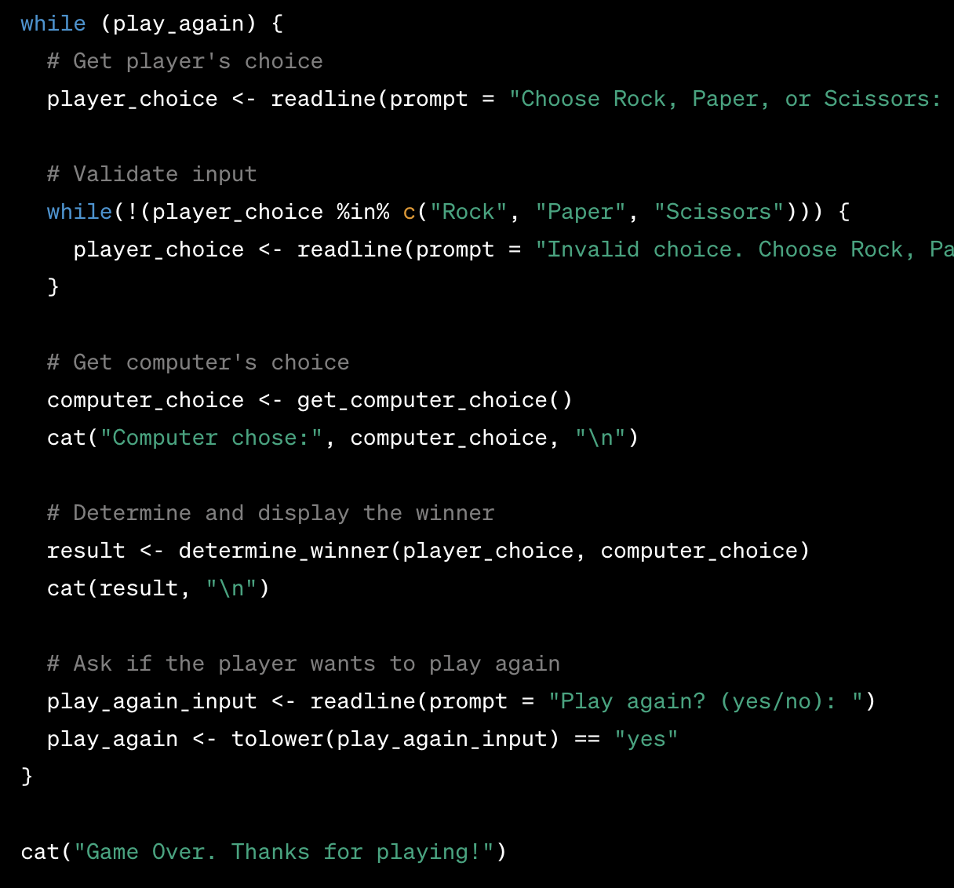
R Code
Notes:
If i told you the C choice and person choice, you should be tell what happens here
Things to highlight in this
Function
If_case cases
Boolean comparison
Loop
Storing a result

Slide 17
Couple of notes on writing, debugging code
“I minored in stack overflow”
I still have to look things up constantly
Knowing programming makes me better at:
Defining problems
Developing solution strategies
Solving harder and harder problems
Documentation, Google, Stack Overflow, and ChatGPT can help you from there
But if you don’t know how to define and solve problems, you won’t be able to take full advantage of these aids
Notes:
Youll see me constantly googling, looking up documentation and asking chat gpt questions
But to actually get anywhere, I need to be able to define the problem and a solution strategy
Like I said at beginning, knowing the basics of programming will help you know how to create solution strategy bc youll have practiced

Slide 18
Couple of notes on writing, debugging code
“I minored in stack overflow”
I still have to look things up constantly
Knowing programming makes me better at:
Defining problems
Developing solution strategies
Solving harder and harder problems
Documentation, Google, Stack Overflow, and ChatGPT can help you from there
But if you don’t know how to define and solve problems, you won’t be able to take full advantage of these aids
Notes:
Youll see me constantly googling, looking up documentation and asking chat gpt questions
But to actually get anywhere, I need to be able to define the problem and a solution strategy
Like I said at beginning, knowing the basics of programming will help you know how to create solution strategy bc youll have practiced

Slide 19
ChatGPT and other AI tools
Any of them could probably solve all of what we do in this class
But they can’t solve everything you’ll eventually want to do
You can’t get to the cutting-edge problems without basics
At the very least, you’ll be limited
Learn basics so that you can get to hard problems, and use AI as a collaborative aid once there

Slide 21
Notes:
Broadcast version

Slide 22
Notes:
Broadcast version

